Slide 1
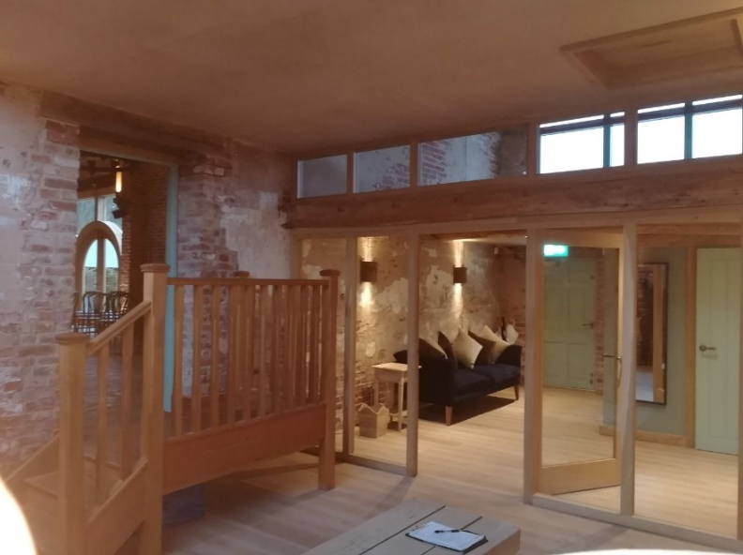
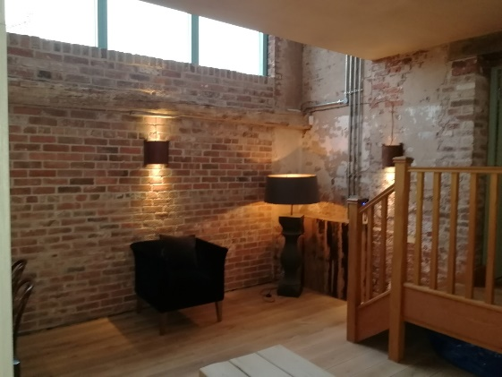
Hazel Gap Barn, Edwinstowe
Value of contract:
Length of contract:
Contract start date:
Completion date:
£10,000
3 Weeks
Nov 2018
Dec 2018
Works/services provided:
Supply and Install Bespoke Oak framed glazing
Construct timber ceiling, including lightwell to retain natural light
Plastering
Roof insulation
Detailed description of contract:
The wedding venue is located in a dramatic red-brick barn on the Welbeck Estate in Nottinghamshire; retaining period features such as high ceilings, large doors and windows, limestone floors
The remit was to enclose the existing Brides changing room, situated at the back of the existing ceremony hall, to reduce sound transfer and improve thermal performance; proving a better environment for the bridal party
Particular challenges to be overcome:
Contact us for more details :-
Fabricating bespoke Oak glazing to match the existing as closely as possible
Co-ordinating the works during two windows of opportunity; between weddings, and meeting a tight deadline
Ensuring that the facility could be re-opened, and safely used by customers, mid-works.
Vaughandale Construction LTD
Ravensdale Mill
4 Elm Tree St
Mansfield
NG18 2HD
01623 634898
Notes:
Project Reference

