Slide 1
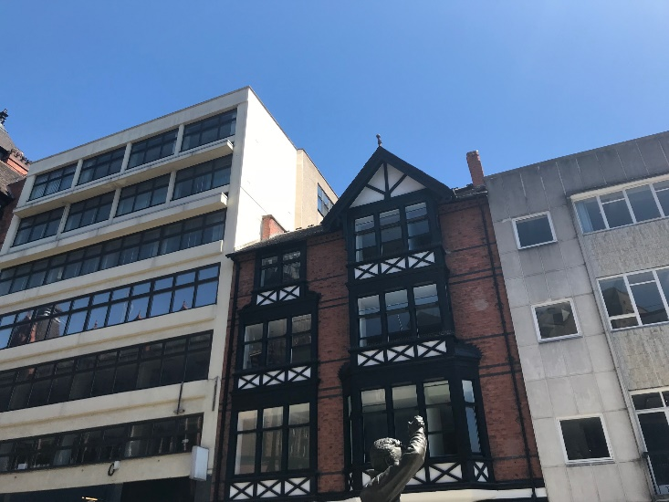
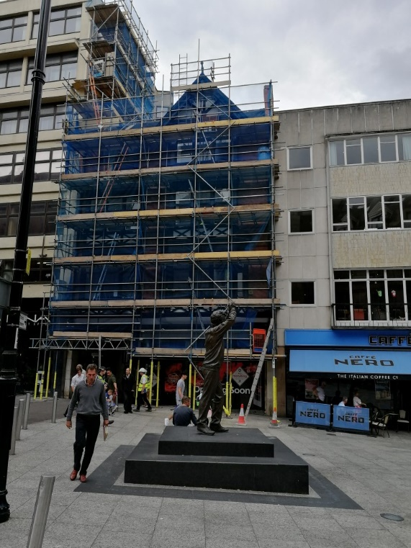
10 King Street, Nottingham
Value of contract:
Length of contract:
Contract start date:
Completion date:
£290,000
4 months
March 2018
July 2018
Works/services provided:
Extensive soft strip and demolitions - by hand
Replacement of rotten structural timbers & installation of steel beams
Repair and replacement of timber sliding sash windows
Acoustic Upgrades; Secondary Glazing, acoustic ceilings, partitions and flooring
Drylining and re-plastering throughout
Mechanical and electrical installations; including monitored fire alarm and heat recovery system
Installation of kitchens and bathrooms
Repairs to the timber façade. Application of through coloured render, 6th 7th & 8th floors
Wall tiling, floor finishes & decoration.
Detailed description of contract:
Conversion of former offices on the upper floors to provide residential accommodation, 6 Nr. 1 Bed student apartments, including; upgrade of floors for fire and accessories; replacement windows; new floor, wall and ceiling finishes; new M&E installation, kitchen and bathroom.
Particular challenges to be overcome:
Contact us for more details :-
Co-ordinating all deliveries and waste collections before 10am Monday to Friday to comply with NCC pedestrian zone
Managing NCC licenses and scaffold movements – 5am till 8am Saturday & Sunday only
Setting up staff welfare facilities within the existing building to satisfy HSE requirements – Regular relocation of the facilities to suit the programme of refurbishment works
Vaughandale Construction LTD
Ravensdale Mill
4 Elm Tree St
Mansfield
NG18 2HD
01623 634898
Notes:
Project Reference

