Slide 1
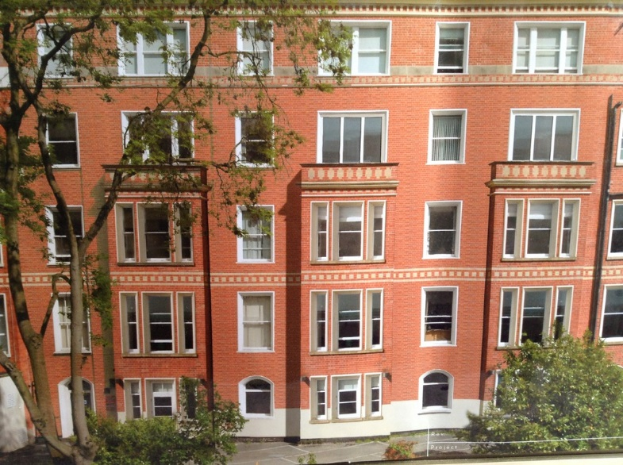
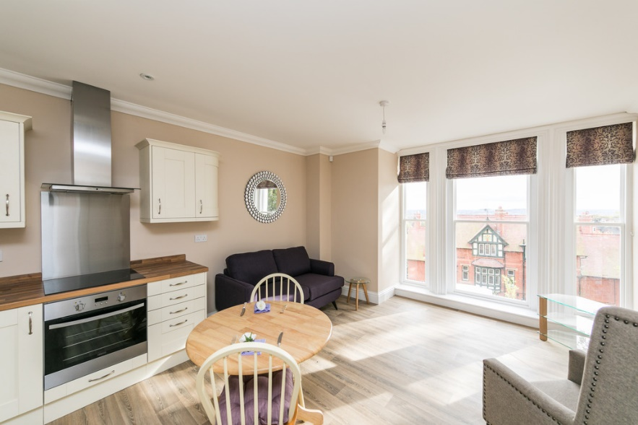
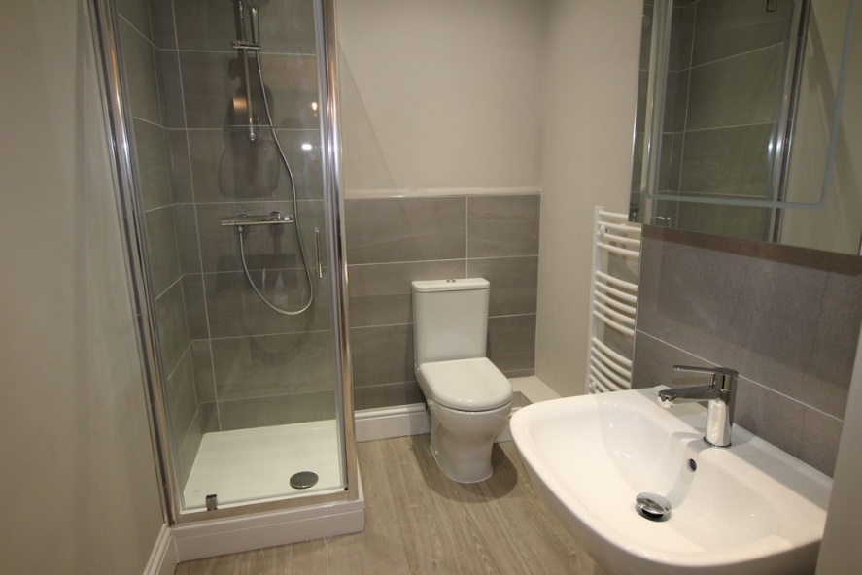
Clinton Terrace, Nottingham
Value of contract:
Length of contract:
Contract start date:
Completion date:
£1,610,000
13 months
October 2016
November 2017
Works/services provided:
Extensive soft strip. Removal of lath & plaster ceilings, partitions and timber floors
Demolition of structural elements; Reinforced concrete staircase and supporting beams, masonry walls, concrete floors
Installation of structural steelwork, columns and beams, to support the new layout. Fireproofing where necessary
Bored mini-piles to support the concrete deck forming the new car park
Works/services provided:
Repair and bespoke replacement of timber sliding sash windows. Installation of purpose made timber staircases
Complex mechanical and electrical design & installation. New underground and above ground drainage systems. Installation of a passenger lift (Four floors)
Acoustic partitions, dry lining, MF suspended ceilings and decorative plasterwork
Installation of fitted kitchens and bathrooms, 2nd fix joinery
Floor & wall finishes, decoration
Notes:
Project Reference

Slide 2
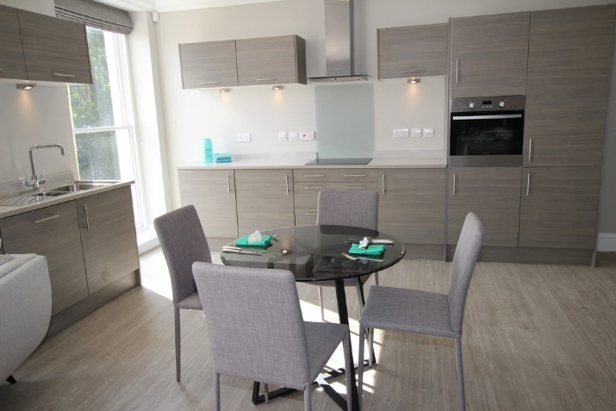
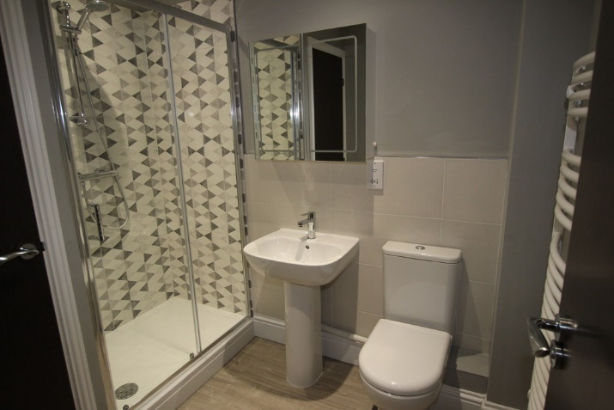
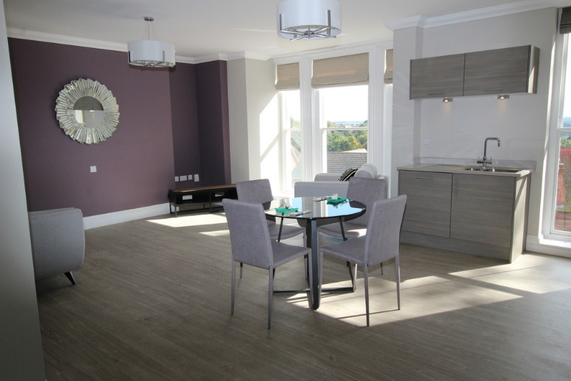
Clinton Terrace, Nottingham
Detailed description of contract:
The works are to convert an existing five storey, 19th Century building currently in use for education purposes into eleven apartments. One apartment will be a duplex and will also be provided with a roof terrace.
The Contractor will be responsible for the design of the Mechanical and Electrical installation and for design of the piling to the extended rear parking area.
Particular challenges to be overcome:
Contact us for more details :-
Sympathetic restoration of the Victorian façade and repair of the sliding sash timber windows
Coordinating an upgrade of the mains electrical supply and installing new foul drainage to service the increased demand
Complicated temporary works installation to enable substantial removal and alteration of the structure
Vaughandale Construction LTD
Ravensdale Mill
4 Elm Tree St
Mansfield
NG18 2HD
01623 634898
Notes:
PR – Page 2

