Slide 1
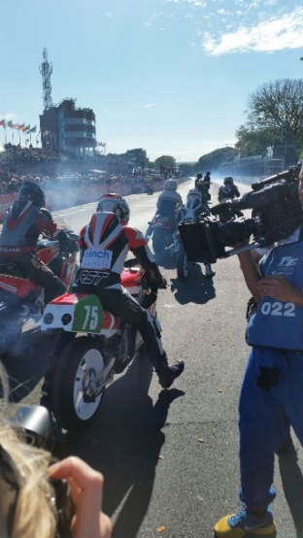
+44 07919 321109
david.binch@binchprojects.co.uk
www.binchprojects.co.uk
PRESS RELEASE – PRESS RELEASE
TT TAKEOVER
BINCH RACING TAKE ON THE NOTORIOUSLY & UNFORGIVING ISLE OF MAN CLASSIC TT.
The Isle of Man is famous for its historical 37.8 mile race course with motorcyclists competing around the TT course for 110 years. Its rich history of testing man and machine attracted Binch Racing to the island to test their luck in the battle for the podium and bring success to the Nottinghamshire based race team.
The Classic TT is a 2-week festival of speed held on the 19th August - 1st September on the Isle of Man. Its popularity is increasing due to the nostalgic feel of seeing the bikes whizz around the Manx roads at top speed. Well-respected and experienced TT rider, Dan Hegarty will be competing on Binch Racing’s TZ250 YAMAHA’s, with team owner, David Binch building the bikes and taking the team over to the Classic TT. Hegarty is one of the top 20 TT riders with a highest average speed of 128mph for the 37.8 miles’ course.
Motorcycle sports have always had a space in Mansfield based Binch Racing’s heart with David, an ex Isle of Man Manx Grand Prix racer, having now changed roles to the engineer rather than the racer. Months of preparation have ensured the bikes have been put together with the highest quality and attention to detail to allow Hegarty to operate the bikes safely throughout the course of the event. Top bikes coupled with a top rider, along with support from quality sponsors ensures the team are enthusiastic about the possible results.
The team thank all their supporters & sponsors.
Follow the action & wish the team, supporters & sponsors good
luck on David Binch’s facebook page.
ITV4 televises the races throughout the event.
Follow the races live on TT Radio

Slide 2
