Slide 1
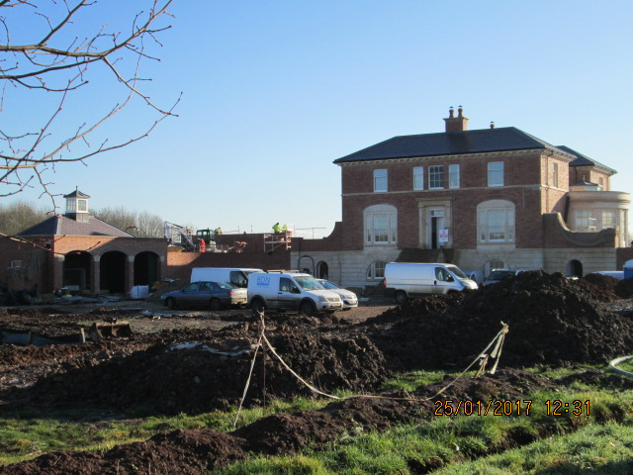
Field House, Car Colston
Value of contract:
Length of contract:
Contract start date:
Completion date:
£3,500,000
24 months
Summer 2015
Spring 2017
Works/services provided:
Demolish & recycle agricultural buildings
Site clearance, Earthworks, UG Drainage
Installation of ground source heating
In-situ concrete foundations & substructure
Masonry walls, Stone masonry
Waterproof tanking to basement walls
Welsh slate roofing, decorative lead welding
Bespoke Mahogany staircase, balustrade
French polishing
Sliding sash timber windows, bespoke doors
Decorative plaster mouldings
Bespoke Timber cabinetry, Marble tops
Limestone flooring, Wall panelling
Hardwood ‘parquet’ flooring
Detailed description of contract:
Construction of a three storey Georgian style house on the site of the former Field House Farm. Works included; separate Garage & Office building, formal garden, Kitchen Garden, approach roads, Driveway & Courtyard parking etc
Particular challenges to be overcome:
Contact details:
Working within Environmental Agency restrictions to protect ecology – Greater Crested Newts
Sourcing master craftsmen for a range of traditional skills
Working closely with the lead architect to agree detailing and an exacting finishes schedule
Alex McIntyre Architects
The Studio, 1 Clinton Terrace
Derby Road
Nottingham, NG7 1LY
Tel: 0115 9599977

