Slide 1
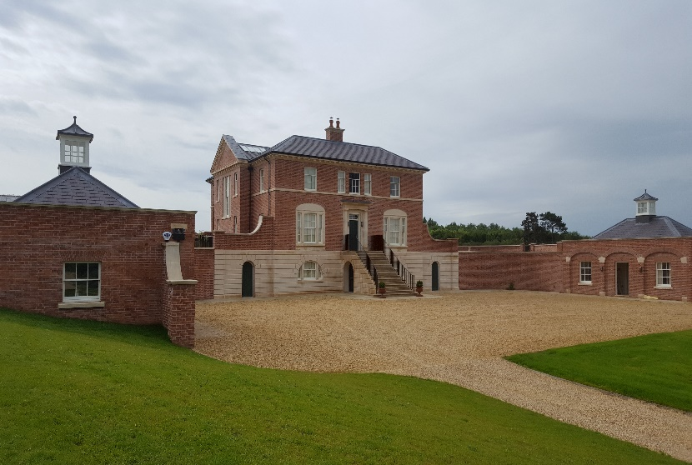
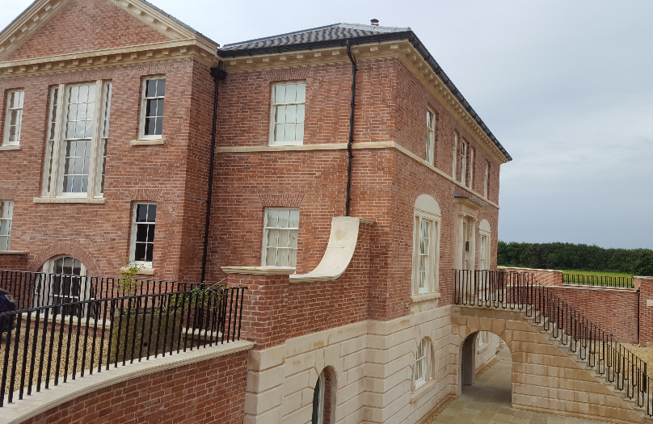
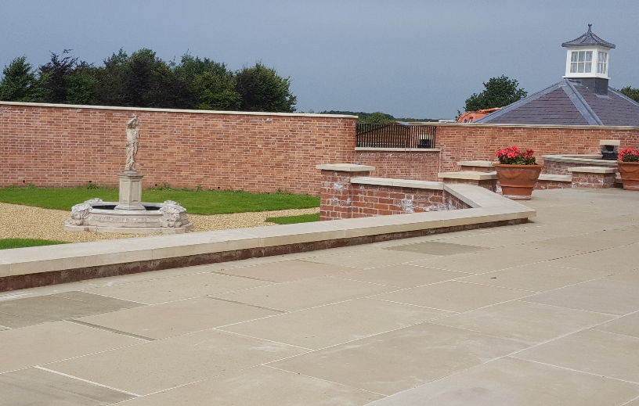
Field House, Car Colston
Value of contract:
Length of contract:
Contract start date:
Completion date:
£3,500,000
24 months
Summer 2015
Spring 2017
Works/services provided:
Demolish & recycle agricultural buildings
Site clearance, Earthworks, UG Drainage
Installation of ground source heating
In-situ concrete foundations & substructure
Masonry walls, Stone masonry
Waterproof tanking to basement walls
Welsh slate roofing, decorative lead welding
Works/services provided:
Bespoke Mahogany staircase, balustrade
French polishing
Sliding sash timber windows, bespoke doors
Decorative plaster mouldings
Bespoke Timber cabinetry, Marble tops
Limestone flooring, Wall panelling
Hardwood ‘parquet’ flooring
Notes:
Project Reference

Slide 2
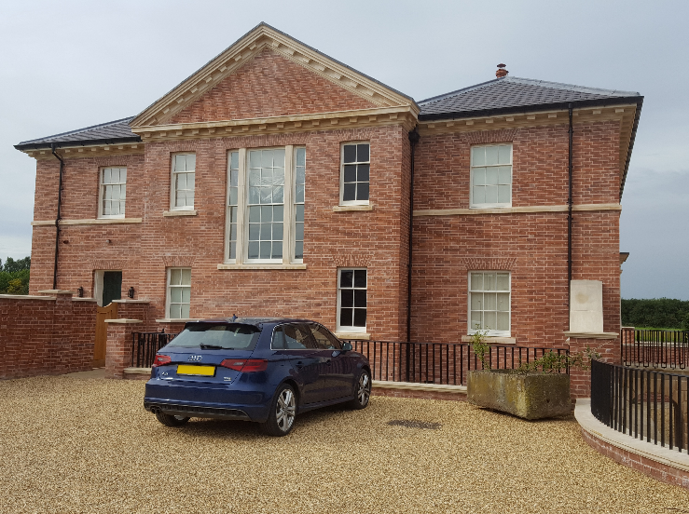
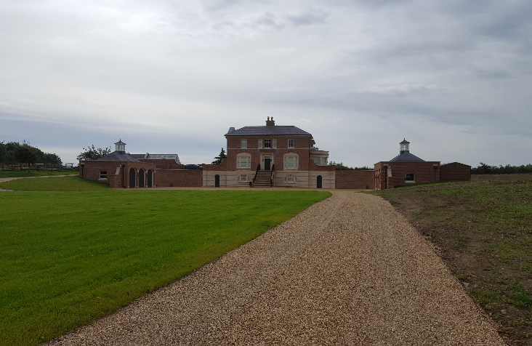
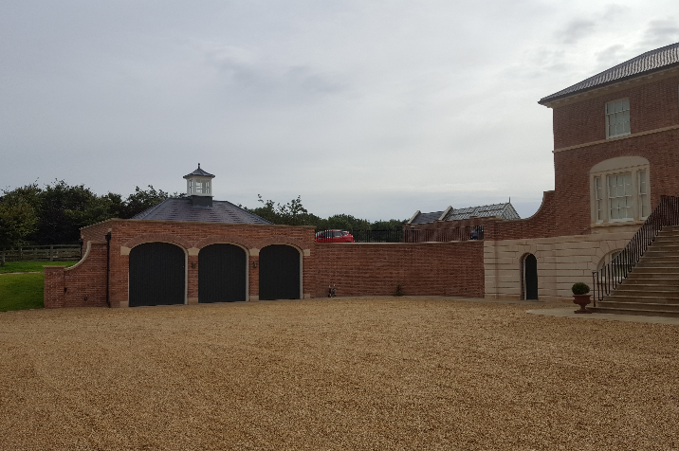
Field House, Car Colston
Detailed description of contract:
Construction of a three storey Georgian style house on the site of the former Field House Farm. Works included; separate Garage & Office building, formal garden, Kitchen Garden, approach roads, Driveway & Courtyard parking etc
Particular challenges to be overcome:
Contact us for more details :-
Working within Environmental Agency restrictions to protect ecology – Greater Crested Newts
Sourcing master craftsmen for a range of traditional skills
Working closely with the lead architect to agree detailing and an exacting finishes schedule
Vaughandale Construction LTD
Ravensdale Mill
4 Elm Tree St
Mansfield
NG18 2HD
01623 634898
Notes:
Project Reference

