Slide 1
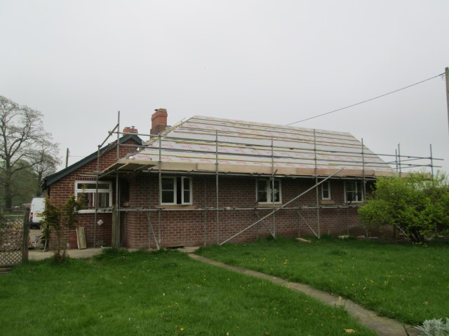
Hardwick Park Farm, Hardwick Estate, Norwood
Value of contract:
Length of contract:
Contract start date:
Completion date:
£90,000
4 months
August 2012
November 2014
Works/services provided:
Insitu concrete foundations
Masonry superstructure
Traditional ‘hipped’ timber roof & welsh slate covering
Bespoke timber windows and external doors
Mechanical & electrical installations
Plaster finishes and decoration
Installation of fitted kitchen and bathroom suites
Detailed description of contract:
A single storey pitched roof extension to the existing farm house to provide modern spacious living accommodation for the tenant farmer and his family. The new floor plan includes: three bedrooms, new bathroom facilities, extensive alteration to the existing living areas. We have worked closely with the Trusts Building Surveyors., Conservation Officer and Ecologist to ensure that their specific requirements are met.
Particular challenges to be overcome:
Contact us for more details :-
Phasing the programme of works and providing temporary screens to minimise disruption to the residents living in the property throughout the works
Matching the existing masonry walls –Facing brickwork & Stone features – to provide a seamless appearance
Managing vehicular movements around a busy farm yard and livestock
Vaughandale Construction LTD
Ravensdale Mill
4 Elm Tree St
Mansfield
NG18 2HD
01623 634898

