Slide 1
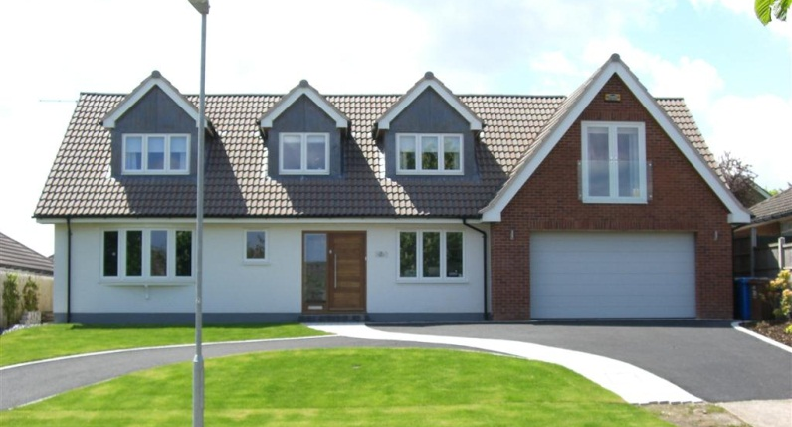
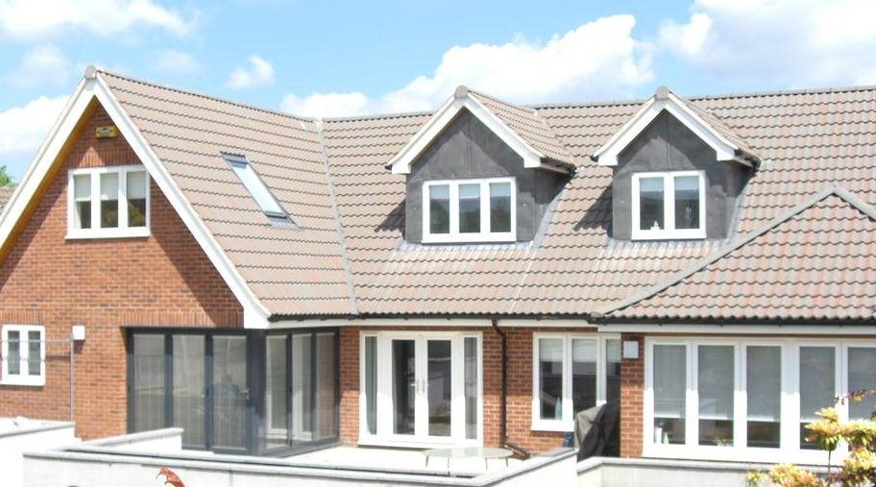
20 Chestnut Drive, Mansfield
Value of contract:
Length of contract:
Contract start date:
Completion date:
£375,000
12 months
August 2010
September 2011
Works/services provided:
Strategic Demolition of the existing dwelling
Insitu Concrete foundations and floor slab
Masonry Structure, clay facing brickwork with elements of acrylic render finish.
Traditional Timber Roof Structure , five dormer windows, with concrete tile finish.
Complete Electrical installation including energy efficient “LED” lighting throughout
Design & Installation of gas fired central heating. Including elements of underfloor heating.
Rainwater harvesting and distribution of non-potable water to WC’s.
Porcelain tiling to floors & walls
Solid hardwood “Parquet” flooring
Bespoke internal joinery: - Staircase, doors moulds,
External paving and landscaping
Detailed description of contract:
Partial demolition of existing chalet bungalow , circa 1963, and new-build construction of four bedroom bespoke residence complete with double garage and feature glazing to the rear elevation.
Particular challenges to be overcome:
Contact us for more details :-
Stabilisation of the existing structure to be retained, design development of the traditional timber roof to include “glu-lam” beams thus overcoming retro fit logistics
Careful removal and sympathetic reinstallation of certain elements in order to retain an authentic appearance
Vaughandale Construction LTD
Ravensdale Mill
4 Elm Tree St
Mansfield
NG18 2HD
01623 634898

