Slide 1
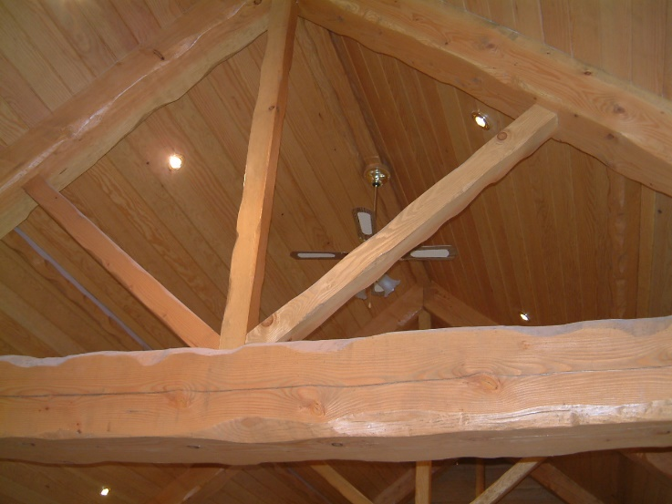
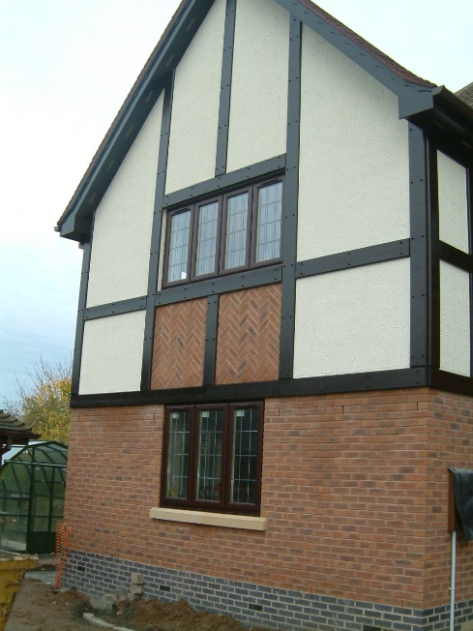
14 High Leys Drive, Ravenshead, NG15 9HQ
Value of contract:
Length of contract:
Contract start date:
Completion date:
£165,000
6 months
June
January
Works/services provided:
Excavation and installation of mass filled concrete foundations
Large pre-cast concrete soakaway & underground drainage
Beam & block pre-cast concrete floors
Masonry walls; blockwork & feature brickwork
‘Mock Tudor’ timber framework & through coloured render finish
Installation of New and Replacement of timber windows for UPVC
Timber roof structure with feature trusses and ‘Douglas Fir’ soffit boarding
Engineered timber flooring throughout the FF and porcelain tiles to the GF
Detailed description of contract:
Construction of Two Storey side extension in a ‘Mock Tudor Style’ to closely match the existing dwelling. The project included construction of a ground floor ‘single storey’ reception room with decked balcony at first floor level leading to the games room. The ground floor extension included Cinema, Gym, Utility room and enabled the creation of a larger open plan kitchen.
Particular challenges to be overcome:
Contact us for more details :-
Deliver materials to the to the side of the home with large vehicular plant; Concrete wagons, cranes and the like
Construct the feature timber roof to achieve the desired aesthetic while lining through with the existing roof structure
Vaughandale Construction LTD
Ravensdale Mill
4 Elm Tree St
Mansfield
NG18 2HD
01623 634898

